Slide 1
Homework for Week of 2/2 Slide 2 – Monday Slide 3 – Tuesday Slide 4 – Wednesday Slide – 5,6 Thursday

Slide 2
2/2
1. In the closet, there are 10 shirts and 15 pants.
a) Use a ratio table to find the simplified ratio of shirts to pants.
b) Use a graph to represent the ratio of items in the closet.
2. In my pocket, I have 8 quarters and 6 dimes.
a) Use a ratio table to find the simplified ratio of quarters to dimes?
b) Use a graph to show the fractional portion of the coins in my pocket that are dimes?
3. On the bookshelf, there are 16 paperback and 20 hardback books.
a) Use a ratio table to find the simplified ratio of paperback to hardback books. b) Graph the ratio.
4. During gym class, there are 7 footballs and 49 tennis balls.
a) Use a ratio table to find the simplified ratio of footballs to tennis balls.
b) If the ratio of footballs to tennis balls stays the same and there are 21 footballs, how many tennis balls would you expect? Graph your results

Slide 3
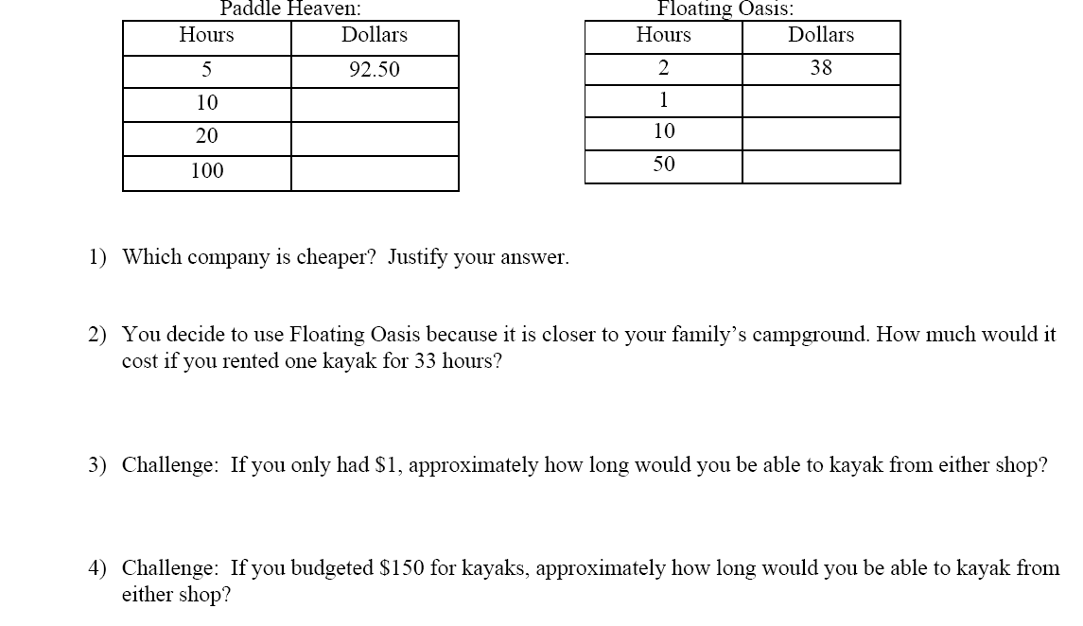
2/3

Slide 4
2/4
1. You can buy 8 apples for $2.00.
a. Find the unit rate for 1 apple.
b. Find the unit rate for $1.
2. The flight from Oakland to Salt Lake City was 720 miles and took 180 minutes.
a. Find the unit rate for 1 minute.
b. Find the unit rate for 1 mile.
3. At the store, you can get 15 cans of peaches for $3.
a. Find the unit rate for $1.
b. Find the unit rate for 1 can.
4. Traveling between countries means exchanging currencies (money). Suppose the exchange rate is 3 dollars to 2 Euros.
a. How many Euros would you receive in exchange for 1 dollar (the unit rate for $1)?
b. How many dollars would a person receive in exchange for 1 Euro (the unit rate for 1 Euro)?
5. Emina can swim ½ mile in ¼ hour.
a. What is his average rate per hour?
b. What is his average time per mile?
6. In 1/10 of an hour, Janet can clean 5/8 of a window.
a. What is her average rate per hour?
b. What is her average time per window?
7. Henry eats 2 ¾ slices of pizza in 20 minutes.
a. What is his average time per slice?
b. What is his average number of slices per minute?
8. In 9 minutes, Guillermo reads 7 ½ pages of the novel.
a. What is Guillermo’s average reading rate in pages per minute?
b. What is Guillermo’s average reading rate in minutes per page?

Slide 5
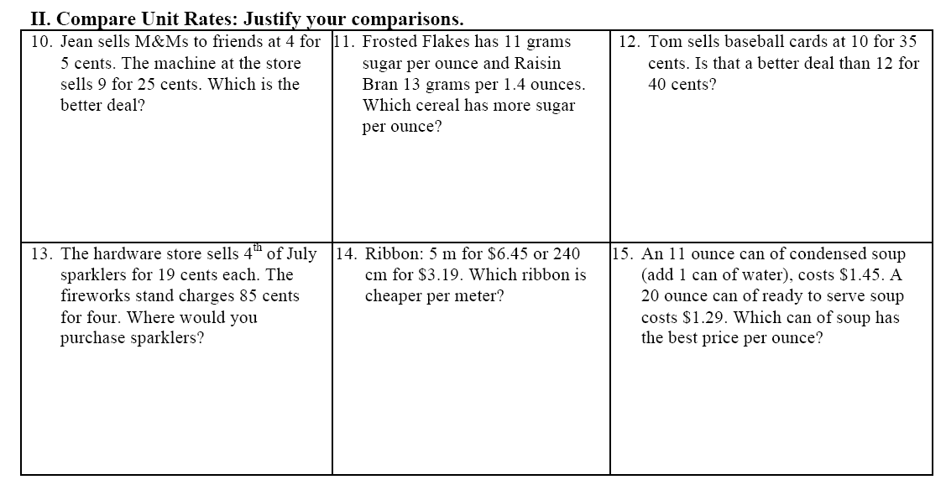
2/5

Slide 6
