Slide 1
Homework Week of January 6th
1/6 Modeling Equations slide 2
1/7 2-Step Equations slide 3
1/8 Multi-Step Equations slide 4

Slide 2
1/6 Modeling Equations
Model and Solve each equation. (Rocks and Crates
X + 2 + 2x = x + 10 2. 2x + 3 + 3x = x + 11
2(3x + 4) – 2 = x + 20 4. x + 3x – 10 = 2x + 8
5. 2(-x + 6) + 4x – x = 2(-x) 6. x + 3x – 4 = -20

Slide 3
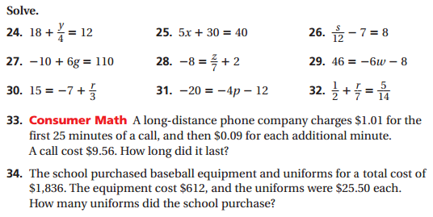
1/7 2-Step Equations

Slide 4
12/8 Multi-step Equations

